Slide 1
Fundamentals of Computer and OS Concepts

Slide 2

Overview Of Operating System
An operating system (OS) is a set of programs that control the execution of application programs and act as an intermediary between a user of a computer and the computer hardware. OS is software that manages the computer hardware as well as providing an environment for application programs to run.
Examples of OS are: Windows, Windows/NT, OS/2, Ubuntu, MacOS etc...
An Abstract view:
Resource Manager
Controller (programs)
Simplify in application development
Acts as Government
User
Non Kernel
Kernel
Hardware

Slide 3
The Computer System
THE OBJECTIVES OF OS:
1. To make the computer system convenient and easy to use for the user.
2. To use the computer hardware in an efficient way.
3. To execute user programs and make solving user problems easier.

Slide 4

Types of Operating System
Batch OS
Multi Programing OS
Multi Tasking OS
Multi Processing OS
Real-Time OS
Batch OS :
Consist of Jobs (Program, input data, control instruction) in the form of punch cards
Non interact (user cannot interact with the OS)
Similar jobs are grouped and in a single batch
Batch
User 2
J1
J2
input
CPU
OS
output
Operator
User 3
Jobs
J3
J4
User 4
User1

Slide 5



Multi Programing OS
execute each process at a time
current executing process cannot be forcefully removed from CPU
Multi Tasking OS
Is an extension of multi programing
Can forcefully remove the currently executing process on the basis of time slots: time sharing or fair share.
Main memory
CPU
Terminate (output)
P3 P2 P1
P1
Execution
P1
P3 P2 P1
Execution

Slide 6
Multi Processing OS (Tightly Coupled)
extension of multi tasking OS
involves multi CPU’s
each process or task is processed in each CPU
P1
P2
P3
P4
p1
CPU 1
p2
CPU 2
p3
CPU 3

Slide 7
Real-Time OS (RTOS)
Definition:
A system is said to be Real Time if its required to complete its work and deliver its services on time.
This type of OS is bounded by time constrain and there are two types;
Hard Real Time - The process should be completed at the exact time (purely deterministic)
Soft Real Time – The should be completed within the time bound (timing is not important than the output)
Examples of Hard Real Time OS would be:
timed bomb
missile launching
airbags etc…
Soft Real time OS:
Personal Computer
Audio and Video Systems

Slide 8
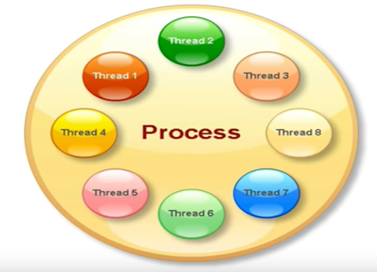
Processes and Threads
Definition:
Process – a program during execution is called a process.
Threads – basic unit of execution, or a collection of instructions formed together to produce a specific task.

